Slide 1
Object-oriented paradigm and Software design
Il-Chul Moon Dept. of Industrial and Systems Engineering KAIST
icmoon@kaist.ac.kr
Notes:
For this week, we are going to study an object-orientated paradigm and software design.
While we’ve learned how to make a program, now it’s time to learn how to design a good program.
To use a metaphor, we previously learned how to use the basic tools such as sawing or hammering. Now we’re going to learn how to incorporate good design in our programs.

Slide 2
Weekly Objectives
This week, we learn the object-oriented paradigm (OOP) and the basic of software design.
Objectives are
Understanding object-oriented concepts
Class, instance, inheritance, encapsulation, polymorphism…
Understanding a formal representation of software design
Memorizing a number of Unified Modeling Language (UML) notations
Understanding a number of software design patterns
Factory, Adapter, Bridge, Composite, Observer
Memorizing their semantics and structures
Notes:
The objective of this week’s lecture is to learn an object-oriented paradigm. In doing so, we’ll learn a good way to design a very basic program.
First, you’ve got to know how to read a blueprint, at the very least.
There is no guarantee that you’ll be able to create sound software design and complicated software at first.
However, you do need to be able to read others’ designs and get the knack of recognizing what is good design.
In this respect, you will study how to set the basic direction of a design – just like naturalism or urbanistic architecture design – for the basic concepts, in addition to ways to implement design.
This is what the object-oriented concept is all about.
After we cover that concept, we will move on and learn how to draw and read a blueprint.
Lastly, there are some things I can’t cover in this lecture. It will, however, be provided to you in the lecture materials.
There are some commonly used patterns for software design, and it will be offered to you as reference.

Slide 3

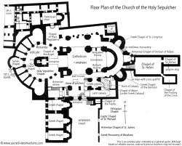





Design and Programming
Software Design
Software Implementation
Development
Python
Lobby 1
Lobby 2
Restroom
Bedroom
Same Role, Similar Design, and Different Interior
Notes:
Previously, we’ve covered why software design is important and how a design and implementation differ from each other.
You can look at it as a blueprint.
This blueprint will be instrumental in the process of constructing.
With a blueprint, however, it is not clear what tools we need to create a building or how we will do the work.
It just a design, the first step in the plans for building this type of house.
In the realm of software, we have to be engaged in development.
During development, an engineer mobilizes various tools and equipment under the guidance of an actual blueprint.
For a more concrete example, let’s consider a lobby and a restroom inside a building.
And there are also other rooms.
If there are two lobbies like this, these places serve a similar role.
Therefore, they are designed similarly.
There are also broad spaces and sofas in these lobbies.
Yet, they can’t be completely identical.
Then, we can change the interior of the building
Although they play a similar role and apply similar designs, what’s actually adopted in realizing the interior would be somewhat different.
Should the architect designer always produce separate blueprints with different features for Lobbies 1 and 2?
He could make a prototype of the lobby with a memo, noting that different interiors are required for Lobbies 1 and 2.
The critical aspects of design are those that must be abided when an existing design is re-used in order to maintain consistency between similar objects that share that design.

Slide 4
Good Software Design
Good or Bad Design?
 | Building Design | Software Design
Correctness | Meet the owner’s purpose Successful construction without faults | Meet the client’s purposes Successful implementation without errors
Robustness | Maintain integrity in a certain level of typhoons | Execute under expected overloads
Flexibility | Enable the future expansions and modifications of the structure | Enable the future updates and expansions of functions
Usability and Reusability | Good support for designed purposes Easy to use for 1) other purposes and 2) other areas | Good support for the designed Easy to use for 1) other purposes and 2) other contexts
Efficiency | Easy to build Cover less area Good mobility in the structure | Easy to implement Smaller size Faster execution
Notes:
What does good software design mean?
In fact, building software is pretty similar to constructing a building.
The most important thing for great software design is its appropriateness.
There is a clear distinction between what’s right and wrong.
What’s wrong basically those fails to meet the goal of a client.
For software to be right, it should satisfy the development objectives of a client.
Even if a design is right, it is still far from good software as long as it produces incorrect outputs or errors.
Hence, software should ensure its correctness to meet a client’s goal without any errors.
The next important factor is robustness.
For instance, some users are always using software and subject it to unexpected stresses.
Even if people do not use the software incorrectly or enter wrong inputs, they can enter excessive input or enter something that was not expected by the programmer.
It’s imperative that a program does not fail.
Thus, a program should respond well to expected incorrect inputs and user habits without errors.
In addition, when you use software over time, you may have to change it.
When a change required, the software should be designed so that you don’t need to disassemble it piece by piece and rebuild it from the beginning.
It should be able to flexibly reflect any possible future modifications.
To support these factors, we’ve got to understand usability and reusability.
For example, it’s necessary for software to fully support the objective of a particular design.
As we cannot force how users deal with software, we have to give them full support.
The interface should be designed to promote intuitive use.
Also, it would be better if this program can be applicable to other purposes
A software may engender thousands of ideas for its applications.
Therefore, it should allow multi-purpose usage.
It should also be designed to be applicable in different environments.
Although a software may satisfy all these conditions, it cannot be good if it takes more than one hour for execution.
In this respect, there are two dimensions of efficiency.
One demands software to be fast and small. The other demands efficiency from a developer’s viewpoint.
The more complex a software design is, the more difficult it is to implement.
Well-designed software should allow a developer to easily comprehend and implement it.
It is simply absurd to remember each of these points, one by one.
I won’t put any questions about all these little details on the test, so don’t worry about it.
However, time and again as your software design practice accumulates, you will naturally recognize what’s important. Now that you’ve taken this lecture, you can review future software design based on what you have learned here.

Slide 5


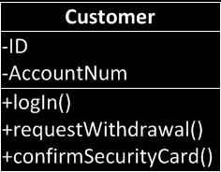
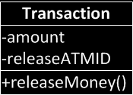
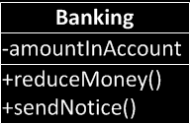
Object-Oriented Design
Real world concepts
Abstract
Abstract
Abstract
Software design entities
Notes:
So far, we’ve covered good design in general.
It does not follow usual design concepts.
It has a universal applicability: that is the ideal.
For example, it serves the purpose for those who apply it, whether the purpose is building naturalism architectures or skyscrapers, and it should be free from errors. It should also be reliable.
Depending on the different situations, how and where the software is stressed would vary. Nevertheless, it should be universally applicable.
Now let’s move on to the topic of design concept.
Design concepts have evolved through diverse paths.
Among the varied design concepts, we will cover objective-oriented design, which has still been being widely used, even though its development dates back to the 1970s and 1980s.
This design is based on the concept that for any program to be good, its design should underpin a real-world concept.
This is the process of turning a real-world concept into the modules of a program.
To demonstrate this, let’s take a banking system and turn it into modules.
There are customers in a bank. They carry out transactions, depositing or withdrawing money.
Also, they use banking accounts to use the functions set up by the banking system.
The users or customers are a concept found in our daily lives.
To modules for a program, we have to determine the name of the concept.
Let’s call it a person with an account, or customer.
Before we move any further, let’s think about the statuses that this real-world concept has. We need to consider its characteristics.
The real world is not static, and things change.
That’s why we need different values for specific moments and situations.
That is a member variable or attribute.
Here, you see three blank spaces.
You can write the name of the concept in the top blank, its characteristics just below, and possible behaviors in the last blank.
The behaviors range from various things including log-in, money withdrawal, and security card check, among other things.
Assigning names is not limited to the subject such as people, but any concept.
Here you see the name, transaction.
And transactions have their own characteristics.
The amount of money, or how much money will be transacted will be classified as characteristics. The ID of an ATM, or which ATM does a particular transaction, can also be defined as a characteristic.
Even abstract concepts have characteristics. This has always held true.
When the last concept is transferred to the real world, a behavior occurs.
“Pay money” is the behavior of a transaction.
Hence, it does not have to be a person to be expressed with names, characteristics, and behaviors. Any abstract concepts can be expressed accordingly through the process of abstraction.
Finally, let’s take a look at the actual banking system.
The banking system also has a name.
It can also contain some information, like how much money is saved in a specific account.
There are various activities such as “lower the amount of money in the account,” “make an announcement,” and more.
Although it shows several characteristics and functions by abstraction, it is obvious that it can define names, characteristics, and behaviors.
This is a process in which real-world concepts can be interpreted into software design entities via object-oriented design. This process is called abstraction.
These entities are names, characteristics, and expected behaviors.
Abstraction permits us to express real world concepts in the form of software design entities.
What is abstraction?
Abstraction is the process of simplification of a complex concept so as to meet the objectives of a design.
It also removes redundant parts and focuses on encapsulating our main interests.

Slide 6







What are Class and Instance?
Class vs. Instance
Class
Result of design and implementation
Conceptualization
Corresponds to design abstractions
Instance
Result of execution
Realization
Corresponds to real world entities
ID: John Acct #: 123
ID: Park Acct #: 456
ID: Kim Acct #: 789
ID: Koh Acct #: 035
Notes:
As a part of a software design concept, we’ve gone over an object-oriented design.
Using object-oriented design, we’ve abstracted some concepts to translate them into software design entities.
We’ve created a software entity for the people we’re dealing with: the customer. The customer is a single concept, and there are many customers.
Now, how can we express a number of customers as a software entity?
The truth is, we do not express them as a single software entity but with multiple instances.
At this point, let’s recall the concepts of class and instance that we’ve covered in the previous lecture.
A class refers to a single design and its implementations.
It will be something like a blueprint part or software design.
Although there is only one blueprint, we can create several instances by coloring it, relocating it, or making other specific modifications.
When a program is run, it can generate multiple instances.
Prior to the execution of the program, we still may not know many instances would be produced.
This, however, is not the case for a class.
A class is used for designing and implementation.
Thus, we have to operate software to pin down how many instances there are.
In other words, this is called realization.
It is about using an abstract blueprint called class. It constructs several houses, and software modules are applied to generate how many instances are produced.
In the banking example, there are various customers including John, Park, Koh, and Kim. They become separate instances by switching some characteristics here and there.
This is the template or design that is the only thing shared by multiple customers.
When we illustrate customers, what concepts do we express? Conceptualization works the same for all customers.
Put simply, a bank can define individual customers by their ID and account number. Every customer has this information, which is how they are expressed in the software.
Independent, several software instances may carry out the same behavior.
The very action of employing member functions that are designed by a class itself is already involved in the process of creating multiple elements.
Thus, we can produce multiple instances that identically designed by abstraction.
It makes the most out of a single design, expressing and representing the many entities present in the real world.

Slide 7
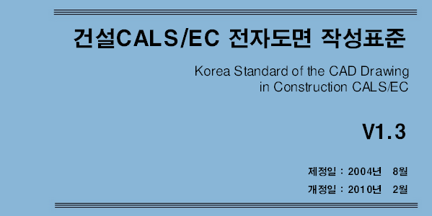
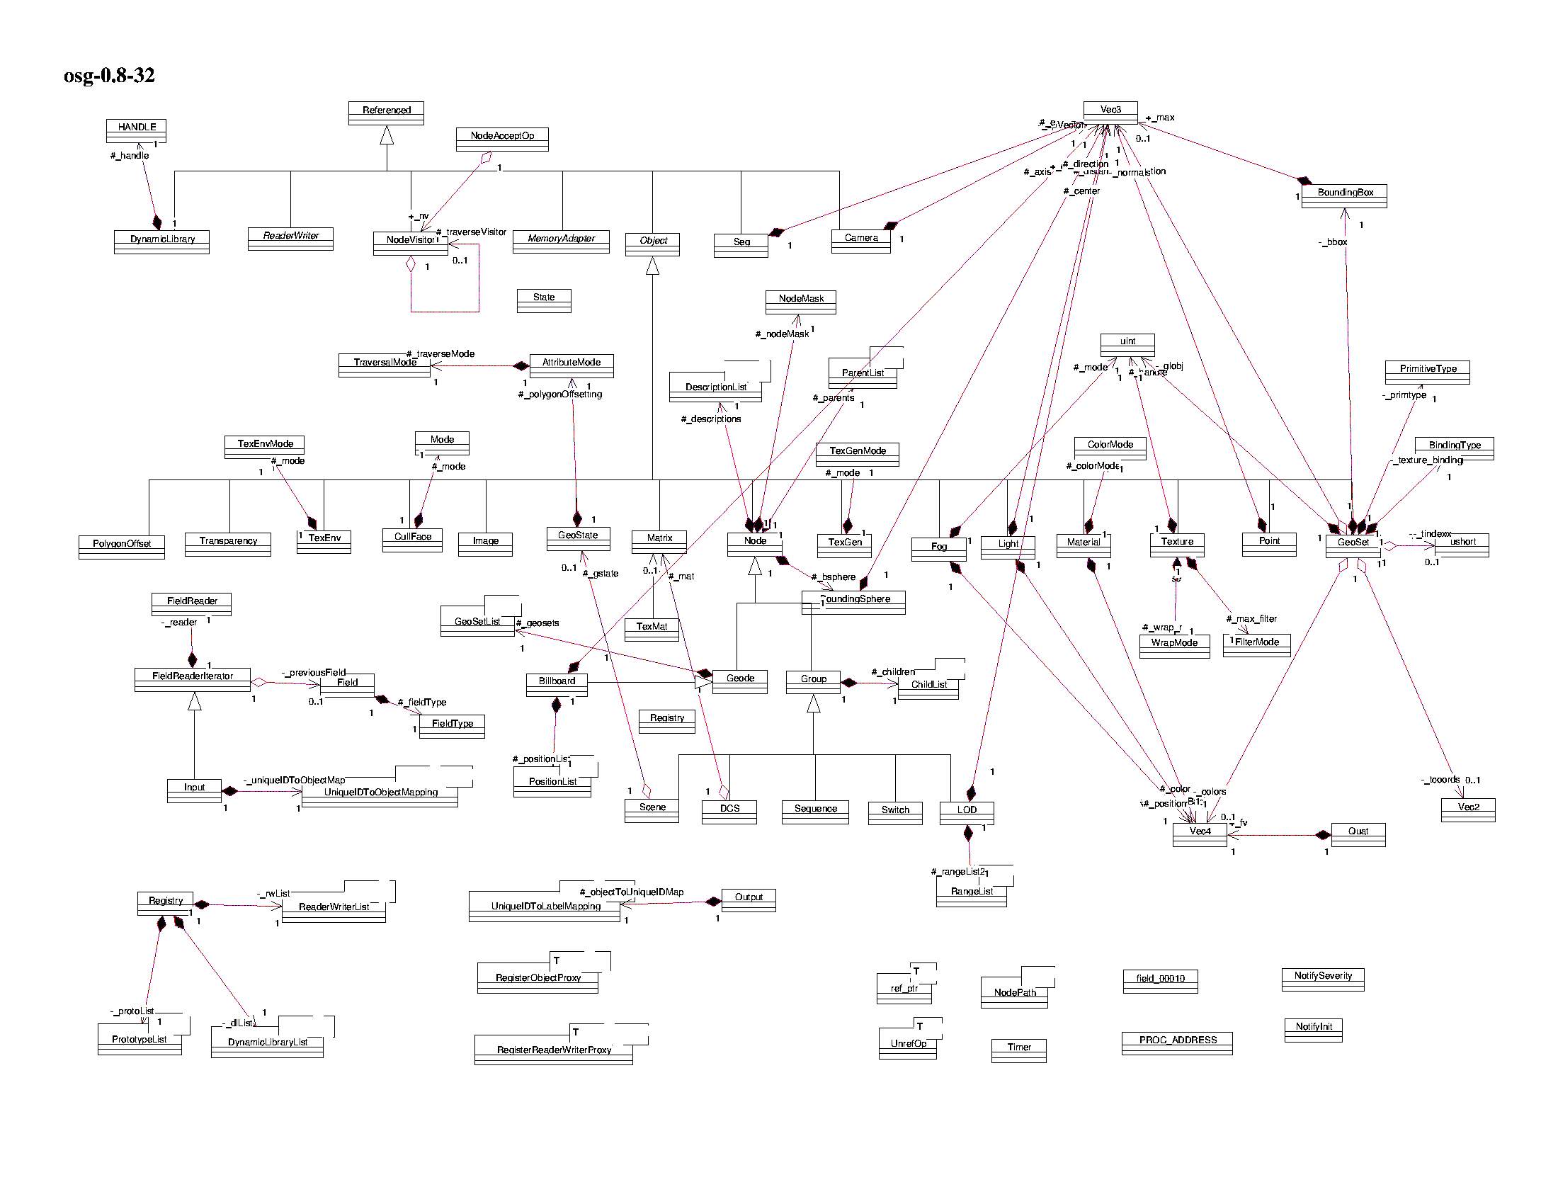

Software Design as House Floorplan
After your graduation, some of you will be constructors of software
Mainly design
Some coding
Need to learn how to communicate your colleagues
Learn standard
Learn how to represent your design to your boss
In software engineering,
UML is the standard
Notes:
Previously, we’ve learned that we have to express a range of entities that we find in reality by using a design.
To do so, we needed to carry out a task called abstraction.
The design of software is analogous to a blueprint.
A blueprint is not drawn at one’s own whim. It needs to follow certain standards.
We should draw a blueprint in accordance with the standards.
Likewise, it is highly likely that you’ll be creating software after graduating from university.
It is said that 30% of our graduates will go into the IT consulting sector.
Although 100% of the work you do in IT consulting firms won’t be coding, you still have to be engaged in design, which requires you to draw something like a blueprint.
You need to know how to cooperate with software designers or other types of designers to smoothly communicate your blueprints.
That’s why we have these types of standards.
Thus, we have to understand the standards for designing software.
One of the standards for software designs is the Unified Modeling Language offered by the OMG group.
It provides a guideline to draw a blueprint for software.
This is often abbreviated and called UML. UML is implemented as a standard for software design in the field of software engineering. It is a type of engineering devoted to design, and research efforts to find out how to create good design are being carried out.
You have to learn how to express various entities or relationships in the real world in an abstract form through the standards, UML.
Let’s delve into the ways we use abstraction to describe reality.

Slide 8
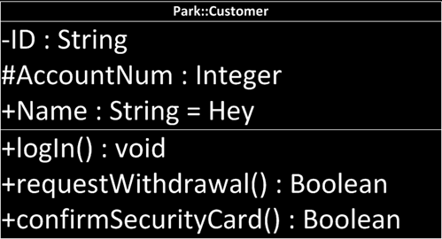
UML notation : Class and Instance
Abstract class
Class
Named instance
Unnamed instance
Person
Customer
Park::Customer
:Customer
Instance Name
Class Name
Member variables
+-#(name):(type)=(default value)
Visibility options
+ → public
# → protected
- → private
Methods
+-#(name)(arguments):(type)
Notes:
Let’s find out how to draw a UML design that features what we’ve repeatedly covered – class.
There are a variety of blueprints for a building, including a front view, a floor plan, a wiring diagram, etc.
The same applies to software.
Although diverse blueprints are necessary for developing software aside from one for class, one of the most commonly used blueprints is the method for design classes.
This week, we are going to learn how to draw a class in the UML.
Although there are other types of blueprints available, we won’t deal with them.
I’ve explained classes and instances many times before.
A class can be viewed as a sort of template. If it is realized, it can be used to create a number of instances.
There is also an abstract class.
We will go over that subject later.
There is a class, which has already been defined, and named instances.
You may see them as it made an instance called Park based on a class, customer.
There is also a case where the name of a variable is not determined but still is there an instance.
And as you can see, the instance name is set as Park.
It will use a colon (:) twice.
Then, add the class name.
When an instance name has not yet been determined, it will just write it without the colon (:).
A class can be divided into an attribute and method.
It is also denoted by various names such as member variable and property.
A method is also sometimes called a member function.
They are denominated in various ways.
Now, let’s apply signs including addition (+), subtraction (-), and the number sign (#).
They will represent the visibility option.
I won’t go into detail about this in this class.
The way to define visibility option is like this. If the content of a class are defined as: public, it is open to all. If it’s protected, it is only available to the person who wrote the program. If it’s private, it can only be viewed inside a class.
For the purpose of the lecture, the modeling of the most programs here is defined as public. In reality, however, the preferable mode is private.
A private option assumes responsibility for its own classes and allows access from others through this method.
You can see that the visibility option is attached to a method.
Using a method, it always controls the data within.
In other words, it obligates my data control to only use my method.
A private method is an effort to ensure my software’s safety by preventing any arbitrary modifications from others.
Next, a name refers to the name of a variable.
Methods have names, too.
The name for a method is shown like this.
In Python, variables come with different types.
Although variables have their own types, they are not declared. Variable names aren’t stated. Instead, they’re automatically assigned with the allocated values.
There are types for variables, but we assign them with corresponding values.
Thus, it is clear that there is a type in Python, and we have to carry out some type modeling.
So, as you see here, we shall define various types including string, integer, string, etc.
A method, or function, requires a variety of types.
First of all, we need to define an input parameter or argument, and then a type for returning.
Here, you will find the definition of the type concerning a return.
There is not a definition for an argument.
We can define a type inside the brackets.
Finally, a function has a way to define a default value.
The name “Hey” is a default name that can be changed at any time by a method later.
As such, I’ve designed a class.
Although there are no details about each method, the class informs us that there are at least three methods and three attributes.
This design can be used to make a basic framework for classes.

Slide 9

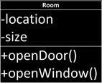


Encapsulation
Object = Data + Behavior
Data : field, member variable, attribute
Behavior : method, member function, operation
Delegating the implementation responsibility!
Bring me a sausage, and I don’t care how you made it
Utilizing the visibility
private: seen only within the class
protected: seen only within the class and its descendants
public: seen everywhere
Python does not support the visibility options!
Building Architecture
I care overall composition
Interior Designer
I care inside implementation
Class Definition
Interface as a specification
Notes:
We’ve looked at how to design a class before.
Let’s get an understanding of the concept by designing a class.
It is a design style based on a class design.
This concept is called encapsulation.
In encapsulation, any content should be inside a class, and this content is accessed only through methods.
Basically, an object is the sum of data and behavior.
Data is called a field or property while behavior is referred to as a method, member function, or operator.
When data and behavior are put together, we have something called an object.
We know that an object will have data inside it.
However, we are going to create certain data by using behavior.
It will limit access to a given behavior and keep how the internal data is stored intact.
We have no idea over how the wiring is arranged inside this thing, but are able to see two wire threads coming out.
We shall not touch anything inside the case, but we’ll control what’s inside with these two wires.
As such, as Python offers the controllable function named as behavior, we can access data with the function.
Using it allows us to delegate any responsibility for implementation to others.
If I have to modify the data to some degree, and if many people get involved with the data and modify it, then it makes difficult for me to track down when and how the data is changed.
Thus, any modification to the data is to be confined to its own behavior.
For instance, it’s like saying I will cook some sausage, and it’s none of your business how I cook it. I make a capsule over which I have complete control inside and restrict any access from outside.
It can be implemented with a visibility option if I wanted.
As I explained before, we can use a visibility option such as private, protected, and public. As it moves from private to public, more people can see it.
As it goes to the direction of the private, it will become something that “only I can see”.
To implement the concept of encapsulation, it uses the concept to designate the method as public and the data as private to allow the method to manage the data.
Python primarily does not offer a visibility option like this.
Therefore, all attributes found in Python can be accessed from elsewhere.
However, it is possible to make something like a promise in Python.
In Python, if you add two underscores (_) before the attribute name, it becomes a promise not to use the relevant attribute by other people who implement the program.
This is a promise among those engaged in implementation. In case of C and Java, it is possible to adjust the visibility by using private, protected public keywords, and more.
For example, an architect who designs an overarching building should come up with the structure of each room and the interconnective relations among rooms.
The architect is swamped with lots of work.
Thus, it is the role of an interior designer to design a room with a class and decorate the room. This sort of work is not the role of the architect.
That’s how we can distinguish different parts of designs.
It also distinguishes different implementations and considers the interconnective relationship between classes. Consequently, it also determines how to implement what’s inside a single class.

Slide 10

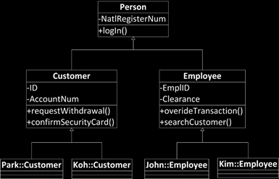
Inheritance
Inheritance
Giving my attributes to my descendants
My attributes include
Member variables
Methods
My descendants may have new attributes of their own
My descendants may mask the received attributes
But, if not specified, sons follow their father
Superclass
My ancestors, specifically my father
Generalized from the conceptual view
Subclass
My descendants, specifically my son
Specialized from the conceptual view
How about having a mother?
Yes. It is possible in Python
Generalized
Specialized
Notes:
Let me explain to you a concept using another class.
I want to talk to you about inheritance.
As you see here, these two people look alike.
It is said that they are father and son.
The son takes after his father.
The people are bound together by lineage exchange information in their genes.
Likewise, we can define data that is passed from one thing to another by inheritance in software.
Put it simply, you can just view it as handing over an attribute to its descendants.
The attributes include my member variables and methods.
I pass my features to my descendants. Here, my features include my attributes and methods.
Perhaps, my descendants may have new characters.
So, it is possible for my descendants to have new attributes of their own.
And my descendants may modify my attributes to have their own attributes.
They have the values transferred from me while searching for their own values.
For example, my daughter significantly resembles me, except her nose.
It seems that my daughter masked some inherited features in favor of her own features.
Everyone has their own individual nose shape. My daughter also has her own shape, but this is not a new attribute.
Parents also have noses.
Let’s say my daughter has a new attribute.
My daughter goes to a child care center, which me and my wife have never attended. So my daughter has a new attribute called a child care center.
It will be a new attribute that’s not shared with us.
As such, a new attribute may be generated, or an inherited one could be modified. Aside from that, the inherited characters will be followed.
Such an inheritance relationship will inevitably beget two different roles.
The 1st one is to the role of a super class that assumes the part of a parent or ancestor.
This is an ancestor.
Looking back into the ancestry, our view is becoming more generalized.
That’s because fewer and fewer things are new as you trace back an ancestry.
As it descends further, more new and tangible attributes are generated.
As it moves upwards, it will be narrowed down to certain attributes that are shared by everyone.
That’s why we call it a generalized view.
Subclasses or children are more specialized.
It ought to be described as specialized since new information is added.
We can denote the father and mother as ancestors without descending them. In reality, we can describe the two with the word “parents”.
As for class, some objects are capable of receiving from multiple classes, while others cannot, depending on the programming language.
In Java, information can only be transferred from a single class to a subclass.
On the contrary, other languages such as C++ and Python can receive information from many classes.
It is possible to have multiple inheritance in Python.
If you see the blueprint, there are persons that have one method and attribute called NatlRegisterNum and login, respectively.
If the person is more specialized, it will deliver the information here as they are.
One entity named “customer” also exists without having to specify it with an attribute called NatlRegisterNum.
Likewise, a method login also exists without any specification.
ID and AccountNum are newly introduced here.
The same goes for “Employee”.
This is the same as a function.
Customer and Employee also have a login function.
When we inherit the generalized person to a customer, the attributes and methods here will be handed over here.
It is advantageous in that it obviates the needs to prepare repeated items.

Slide 11
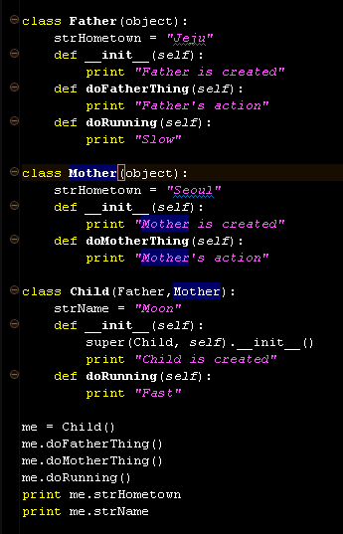
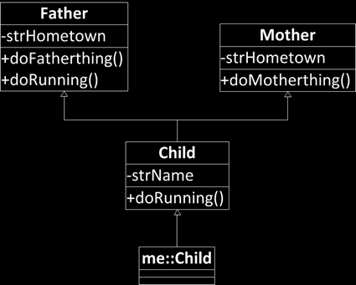
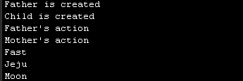
Inheritance in Python
Base Class
(Super Class)
Multiple
Inheritance
See Child has Father’s and Mother’s attributes
See Child overwrite Father’s method by his own
Notes:
The inheritance described before is applicable to various languages.
The inheritance method varies, depending on the programing language.
Let’s find out how it is done in Python.
Let’s consider that we made a class named “Father” in Python.
We’ve declared a class, Father, which has an object within brackets.
And there is an attribute that has the default name of “jeju” for strHometown.
It is related to the presence of the attribute, Father.
Here, you see a constructor.
The constructor will always take place without any specification.
We print out “Father is created”.
Here, methods are implemented in accordance with their relevant designs.
Father is well built, and each method will print out the relevant sentence.
Translating them in reality, they will be syntaxes carrying out various operations.
We are going to conduct a given task by iterating an if-else, a “for” loop and a “while” loop.
There is also a class called Mother.
Mother has a well-declared class, and the object will be put into brackets.
The brackets will accommodate the names of class subject to inheritance.
The object is an empty class placed on the top in Python.
When the most fundamental class is made, an object will be automatically inherited without needing to inherit objects.
The hometown of Mother is Seoul.
While it is possible to conduct Running in Father, there is no Running in the Mother.
As you see here, it also implements a method – doMotherthing.
Then, a child is connected to the Father and the Mother to inherit so as to receive information here.
The child will newly gain strName in this multiple inheritance.
Neither Father nor Mother has a name.
The child has its own name.
Aside from a constructor, there is doRunning, which is also found in the Father with a slow mark.
The doRunning in the child will printout Fast.
After defining them, let’s execute the program.
“me” refers to the child.
It makes a child, not a Father or Mother.
However, it will inherit the information from the Father and Mother.
me.doFatherThing() will call the Father’s doFatherThing.
Before proceeding any further, however, when we initialized the child, we’ve seen a “super”.
The super will call the superclass of the upper level class that I inherit.
Now, a super class as well as the constructor that initializes it will be called.
Here, you will observe that it calls the constructor of the Father, or Father is created.
As a result, it will print out: Father is created, child is created.
Although there is no doFatherThing here, as it inherited member variables and member functions, the member variable and member function will be placed here.
Consequently, the Father’s action is printed out, followed by the Mother’s action with its relocation from here by doMotherThing.
If we call doRunning, it will operate the child’s doRunning. In this case, it’s been modified for the child.
As a result, it will print out fast.
Then the hometown of “me” will be “jeju”, and it will be inherited first.
Although there was no strName found above, it will call its own attribute, Moon.

Slide 12
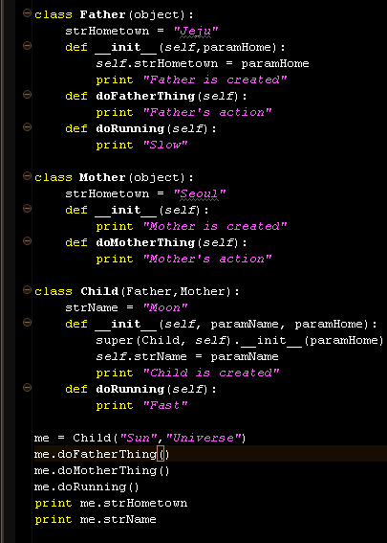
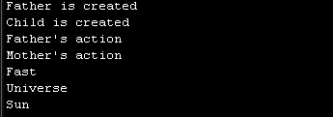
self and super
self : reference variable pointing the instance itself
super : reference variable pointing the base class instance
super is used to call the base class methods.
Referring Father to point Father’s attributes
Referring itself to point its attributes
Notes:
Now we will take a close look at the previously mentioned super, “self”.
A self refers to an instance itself.
Here you will find self.strName = paramName in a child.
However, the self,strName here means that paramNam above I used to update.
So, here comes the “Sun”.
In other words, a self is not that complicated. It’s just an instance of its own.
A super refers to the base class from which it inherits.
In the base class, you will find a super, which represents that a child belongs to its class. A self is in a class called child and searching for its super.
Thus, it finds out an initial constructor to deliver paramName.
It will search for the Father at the very beginning.
We can see that the first inheritance of the Father to call super is up to this point before the period (.). The one searching for a super so far is the Father.
What’s is after the period (.) indicates the Father.
What’s behind the period (.) is the thing to be found.
Here, it searches for a constructor.
It can be viewed that the syntax here will be called by the __init__ behind the period (.).
Lastly, paramHome comes here to update hometown.
Therefore, we can see that when it accommodates the Sun and the Universe, the Universe comes in to update hometown here.
As such, carrying out multiple inheritance, it will call the one that is inherited first. The keyword super is used to find out the ancestor that inherits first.

Slide 13


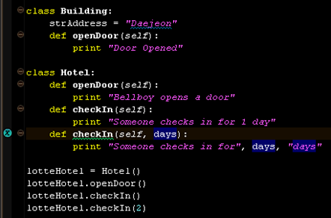
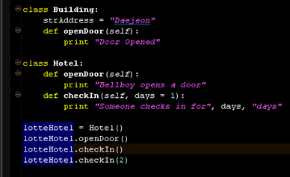

Polymorphism
Light Morph
Black Morph
Polymorphism
Poly: Many
Morph: Shape
Different behaviors with similar signature
Signature = Method name + Parameter list
Method Overriding
Base class has a method A(num), and its derived class has a method A(num)
Method Overloading
A class has a method A(num), A(num, name), and A(num, name, home)
Notes:
We’ve learned about the concepts of encapsulation and inheritance.
Now, I will introduce the concept of polymorphism.
What’s the meaning of “polymorphism”?
Poly means many.
Morph means a shape.
As poly is many and morph means a shape, polymorphism means “diverse shapes”.
If we are to apply the word to a species of creature, a pale colored one will be referred to as light morph and a darker one is called a dark morph.
It example represents that a different behavior occurs.
These creatures are identical from a larger perspective, but they have different details.
The two may both be spotted, but they have different shades.
When two elements share similar signatures, but their behaviors diverge greatly, we consider this as polymorphism.
A signature is also called method signature. It can be viewed as the identifying method.
As people are distinguished by their different signatures, we can discern between different methods with signatures.
The name and parameter of a method will form its signature.
For this function, we have method overriding and method overloading in a polymorph.
Method overriding can be considered as sub1, while method overloading can be viewed as sub2.
Polymorphism is applied on the premise of inheritance. When the base class has a method signature called A(num) and child class has A(num), we can say that the two signatures are identical.
This is the same situation with the previous example of doRunning.
This is called method overriding.
With overriding, the method located at the base class will be ignored. Then, a newly defined method in a child class will be implemented.
In other words, the method suggested by the base will be neglected, and the method defined by the child will be called.
Next, there is method overloading.
Method overloading means that it will have a variety of methods.
While the method name stays identical, it has different parameters to execute various things.
That’s method overloading.
Various operations are adopted to a single method name, so it is overloaded.
Here, you see that a class referred to as a “building” is defined.
openDoor is also defined here.
A class named as “hotel” was defined with the definition of openDoor again.
There are also a range of methods of checkIn(self), checkIn(self, days) constructed.
Next, an instantiation takes place with the hotel.
It assists us to make various calls.
Here, a building is also generated.
A building is constructed, and when you see what’s underneath, it is possible to define strAddress.
The hotel below shows the newly defined statement, openDoor.
If a hotel inherits the building, it will be overridden.
At present, it is necessary to specify that the inheritance has occurred by writing down (Building) on the hotel to perform accurate overriding.
Overloading is used to implement details here.
If we do not have specific values in checkin, it was supposed to check in for a day. With the introduction of parameters, you can start the number of days for the stay at the hotel.
This is typical of Python. Here, days = 1,
The days may be accommodated or not. It can also be called with checkIn().
In this case, a default value of 1 will be automatically applied to the days, and it will be declared as above.
If we apply a specific value in the location, the value will be applied to days, printing out that the stay is for 2 days.
Thus, a default value is used for method overloading.
As such, “override” executes a new method by putting on an identical method signature in the base class. “overload” is used to define how a method signature will behave in a different situation.

Slide 14
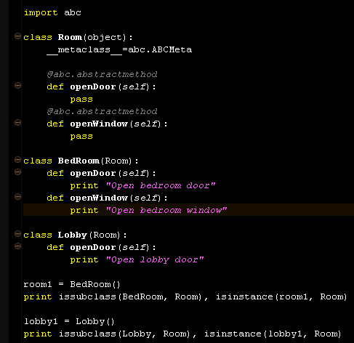
Abstract Class
Abstract class, or Abstract Base Class in Python
A class with an abstract method
What is the abstract method?
Method with signature, but with no implementation
Why use it then?
I want to have a window here, but I don’t know how it will look like, but you should have a window here!
Abstract class is not a complete implementation, it is more like a half-made produce
Therefore, you can’t make an instance out of it
The concrete class with full implementations and inheriting the abstract class will be a basis for instances
Indicator of abstract base method and class
Notes:
We’ve covered a method override previously.
In dealing with a polymorphism, we’ve studied the concepts of method overriding and method overloading.
Now, we will go over what is an abstract class.
An abstract class refers to a class. A class that bears an abstract method is called an abstract class.
An abstract method defines a signature part of the method only.
So an abstract method contains the definition for a signature part, but it doesn’t have the implementation part.
Now, suppose that several engineers are working on something.
Let’s say I’m making a window class.
When we make a window class, even if it’s not determined if it’s a sliding door or a hinged door, it is necessary to specify that it should be open.
That’s when an abstract class is used.
Thus, it allows you to determine a method signature and leave the implementation part to others.
An abstract class is not really competitive information. It’s something like a half-made product.
Therefore, we cannot make an instance out of an abstract class. Abstract classes can’t be executed.
After a general class inherits and overrides abstract methods for full implementation, it will instantiate the inherited general class and subsequently be put to use.
You will find that a class named as “Room” has abc.abstractmethod in the code.
It clearly specifies that it is an abstract method.
There is nothing actually implemented, and there is only a keyword, pass.
It means that this block is completed and has nothing in it.
When there is a Room, it is necessary to write down what’s actually used in the BedRoom(Room) to implement openDoor and openWindow for a full instantiation.
If only one inherits a method and there is nothing to inherit here as in Lobby, it will lead to an error. This is because of the unimplemented abstract method as shown below.
If we do not make this kind of design, there would be nothing like that.
However, if you conduct a design systematically, you will find an abstract class very useful.

Slide 15
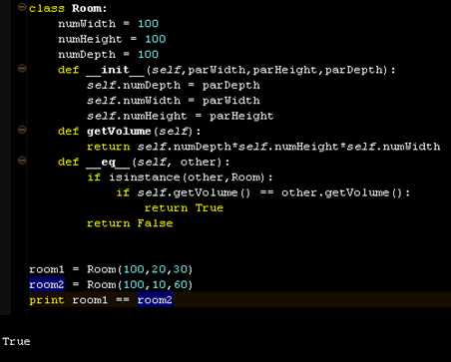
Overriding Methods in object
All of Python classes are the descendants of object
If you don’t specify the base class of your class, then your class is the direct derived class of object
object has many hidden methods
_ _ init _ _
_ _ del _ _
_ _ eq _ _
_ _ cmp _ _
_ _ add _ _
You override them to make the methods behave as you please
Duck Typing
Easier to Ask for Forgiveness then Permission (EAFP)
Notes:
Previously, I said that there is a basic class called an “object”.
It can be said that all Python classes are descendants of an object.
Even if you do not want to inherit it, it can be said that it will receive an object immediately.
If there is no inheritance here, it will accommodate an object as it is.
This object is empty.
However, it hides a method assigned by Python.
We can make the most of it by overriding the hidden method.
Some of the hidden methods in the object are as follows.
__init__ is a constructor.
Overriding the constructor enables us to initialize a basic setting.
That means that there is something inside the object that carries out initializing.
Then, we will override them to apply.
Before, we’ve taken it to be merely declared, but the truth is that the method of an object is overridden.
The same goes for a destructor.
You might find the content below useful.
Unlike “is”, equality compares memory values, rather than a memory space.
If “a” is substituted by 10, and “b” by 10, and we say a == b, then we can easily see that value are being compared here.
However, what are the things that compare complicated classes?
There are three attributes here, and we are going to compare them if they are identical. Then, we can make something out of the __eq__.
If we return True or False, the method will be called during the equality check to produce the equality return.
__cmp__ compares which value is larger than the other. __add__ is applied for implementing addition on the strings.
We can use the basic functions of Python more easily by overriding these hidden methods in an object.
There is something called Duck Type.
Here, we can see that as self.getVolume() is served to pre-determine what is a self, it can call a method, getVolume, in advance.
Using a parameter called “other”, not “self”, however, we can use the getVolume of “other”.
In this case, how can we recognize if other is an instance of the class, Room?
The answer is that we don’t know.
That’s because “other” is not bound to Room only.
So, we built the program under the vague assumption that it would be a Room.
That’s the Duck type.
When other is actually applied, if “other” is the instance of Room, it will operate smoothly.
However, it is also possible it won’t run at all.
When it is not a class named as Room, then this will cause an error during program execution.
Such a policy is called “easier to ask for forgiveness than permission”.
If a program is based on permission, it means that its types are already declared. Only the relevant elements for types will be entered, and so, there are no errors. In a sense, there is nothing to forgive.
However, it is a policy to deliberately allow an error for running a program.
This element contributes to the reputation of Python as a faster programing language.

Slide 16
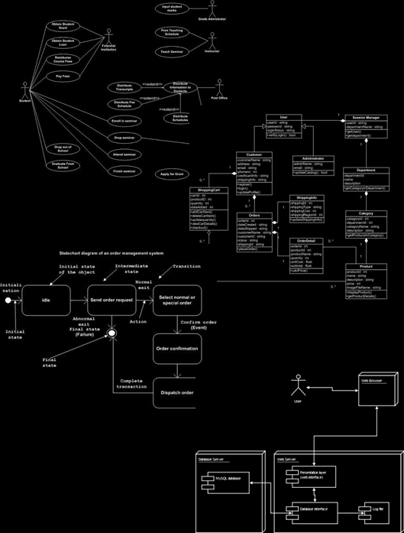
More about UML Notations
Many types of UML diagrams used for different stages of development. If I name a few of them…
Use-case diagram
Class diagram
State diagram
Deployment diagram
We are dealing with OOP in this week
Mainly, class and instances
Also, some of software design patterns
Hence, we focus on
Class diagram
Notes:
So far, we’ve discussed more about classes than UML notation.
We’ve learned how to use classes pretty well.
Also, we’ve talked about how to design a class better.
In reality, there are a range of UML diagrams.
In our class, what we handle will be limited to class diagrams, but there are more of this sort such as use-case diagram, state diagram, and deployment diagram used in reality.
This is a use-case diagram.
The characteristics of the use-case diagram lies in its focus on people. Thus, it represents how people would behave.
As for class diagram, we will be frequently dealing with this type of diagram.
A state diagram allows us to see how the content of a method develops. It would be similar to a flow chart.
A deployment diagram shows that how to make a package and how to organize a server.
As we use an objective-oriented paradigm, we place emphasis on a class diagram and delve into classes further.
Nonetheless, we should not forget that there are various design documents beside what we learned.
Let’s take a deeper look into the UML class diagram.

Slide 17

UML notation : Class and Instance (one more time)
Abstract class
Class
Named instance
Unnamed instance
Person
Customer
Park::Customer
:Customer
Instance Name
Class Name
Member variables
+-#(name):(type)=(default value)
Visibility options
+ → public
# → protected
- → private
Methods
+-#(name)(arguments):(type)
Notes:
We’ve learned all sorts of things about what a class is in the previous lecture.
I bet that now you have an inkling of what an abstract class might be, right?
A person here is something that we need to represent.
There should be an abstract method we can use to represent this person.
For this abstract method to be a class capable of a full instantiation, it should inherit and use it by overriding the abstract method here.
Here, we have an abstract method, which can be transformed into this by overriding the method, which means an inheritance.
This instantiation or unnamed instance is used in a program.
We can define member variables and methods like this.
Visibility options assist an encapsulation.
It is possible to override or overload these methods.
As you can see here, it generates a list for method names and input parameters here. We call this a method signature.
When a method signature holds a constant, we can override a method.
If a signature is identical for the super class and the inheriting subclass, the method of the child class will be the representing one.
On the other hand, if the names of method signature are identical but have similar, different parameters, these will be called overloading methods.
A method overload has a number of methods capable of holding various parameters, but its name should be the same.
As Python offers various default values, we can implement the method overload.

Slide 18
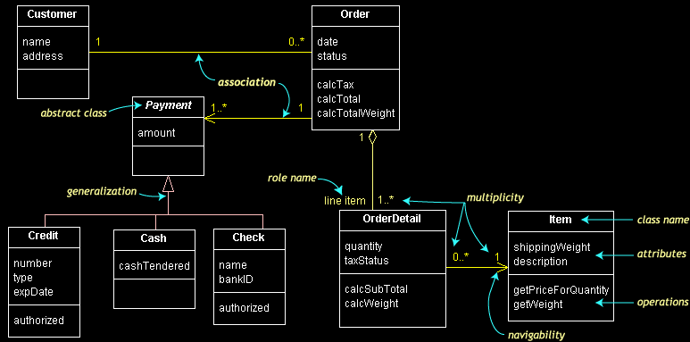
Structure of Classes in Class Diagram
What makes a structure?
Entity and Relationship
Entity
Relationship and its characteristic
Notes:
A big program simply can’t be completed with a single class.
And so, it uses groups of classes.
Now this can be considered a real blueprint.
Here, we have a total of 8 of these classes.
Now, this isn’t a large program.
It’s simple as ABC.
The blueprint specifies what is the mutual relationship among these classes.
For example, if a straight line is drawn between the classes, what would be their relationship?
If you think about it, this represents an association relationship.
We should be able to understand the relationship of the classes through their association.
This requires the ability to read a blueprint.
We’ve touched upon generalization briefly.
Now, let’s talk a bit about inheritance.
Credit is named as a class. It is a subclass of “payment” and inherits the payment.
In the same manner, cash inherits the payment, as does a check.
There are three different methods for producing some values.
What they have in common is that they determine how much to pay, in other words, the amount.
Thus, while they have their shared attribute—the amount—from a payment, each of them demands different elements:
the credit card requires a credit card number, cash needs to note “how much money was collected,” and a name Is needed for a bank check.
This arrow is called a hollow point arrow.
We’re going to call this type of arrow a hollow point arrow.
It’s basically an empty arrow.
The association relationship would be just a straight line or a one-way arrow.
This is a generalization, and that is an association.
In addition, there is another notation we should know.
As you can see, it’s a diamond shaped arrow.
This particular arrow is used to express an aggregation
These classes have different relationships such as association, generalization, and aggregation, through which they’re implemented.
Now let’s find out how to read these relationships.

Slide 19
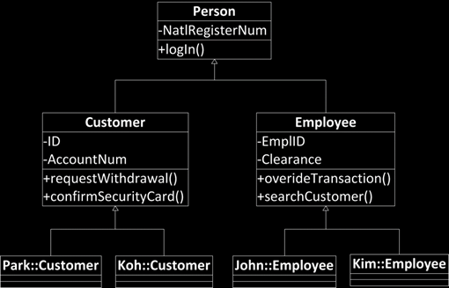
Generalization
Generalization between classes
is-a relationship
Inheritance relationship
Customer → Person
From subclass
To superclass
Direction of generalization
Hollow triangle shape
Base class
Person
Leaf class
Park::Customer…
Notes:
Now we’re going to tackle generalization.
Generalization is primarily based on the inheritance relationship I’ve mentioned before.
Inheritance inevitably produces two different types of classes: super class and subclass.
Another name for it is an “is-a relationship”.
For instance, let’s say, “A customer is a person”.
A customer is a type of a person.
The direction of the arrow is from the customer to the person.
A subclass points out a superclass with a hollow arrow.
True to its name, this is a “generalization”. After all, it’s not a specialization, is it?
The arrow will go toward the direction of a generalization.
The relationship from customer to person is a generalization. The reverse direction would be a specialization.
This is indicated by the use of a hollow triangle shape.
It will have this sort of shape at the tip.
For example, what we may refer to a base class is the person. Over here, Park::Customer, Koh::Customer, are what we would call leaf classes
A leaf is a class at the far end of the base class.
Suppose that this middle part is a stem. The leaf classes are those that branch out away from the stem.
A generalization has the characteristics of an inheritance.
Although it is not declared as an attribute, the national registration number can be found for a customer and employee.
Likewise, while a function, “log in”, is not declared here, it is already included in the method list. It works because it’s already been declared for an employee.
What if we add one more log in here?
This would be “override”.
What would happen if we log in here with some inputs?
This would be a method overload for a method signature that does not make a perfect match with the changed input parameters.
From what we can see, a generalization is closely related to the inheritance we discussed before.

Slide 20
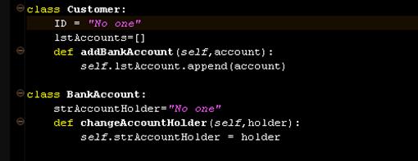
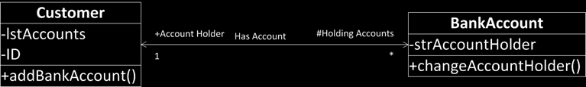
Association
Association between classes
has-a relationship
Member variables
A customer has a number of holding accounts
An account has an account holder customer
Simple line
If a simple arrow is added
A customer has a reference to bank accounts
A bank account has a reference to a customer
Navigability
Line ends are tagged by roles
Account holder
Holding accounts
With prefix showing the visibiliy
+: public , -: private, #: protected
Roles
Navigability
Name
Multiplicity
Notes:
We’ve examined what is a generalization and learned that it is related to inheritance.
However, that is not the case for association, our main topic this time.
We haven’t really discussed about “association”.
Just like how generalization is an is-a relationship, an association relationship is a has-a relation.
A has-a relationship is a relationship in which a class has something.
The meaning of ‘some class has information’ is relevant to member variables.
Let’s look at the source code here as an example.
The customer class has a list called a list account.
It will store a multiple number of accounts.
It even includes a method called addBankAccount.
Now, a customer can have several accounts.
It’s just like how you might have multiple accounts at a bank.
Anyway, this describes that one customer has a number of accounts.
Let’s move on and look at a bank account.
This is a type of account.
Here, you see a string account holder.
We assume that an account holder would designate one customer.
Let’s say that it contains a string for now. It can later accommodate the class information called “customer” after receiving it.
It is imperative for one account to be identified by one customer. The account needs to hold that information.
Hence, we may say that one account has one customer.
Now, a has-a relationship requires multiplicity
This means that has-a relationships must be able to contain plural forms of information.
In the real world, a single customer can have N number of accounts, and one account has one customer.
The expression of an association relationship is normally a simple line that links classes.
Now, there are some occasions in which an arrow is attached.
A simple arrow represents a certain direction, just like when we demonstrated how one customer can have a number of bank accounts.
Put it simply, the arrow is used to show that a certain class has a way to reference the class.
The member variable of the class is holding an indicator that directs it.
Then, what happens if we don’t have an arrow?
It shows that they are mutually connected.
It is used when there is a mutual direction.
In that case, arrows will be applied to both ends, or arrows are omitted altogether.
In this case, an arrow is adopted to demonstrate a one-sided direction. A two-sided arrow or a simple line means that the relevant direction goes both ways.
Basically, an arrow may be viewed as a barometer to show if some navigation is allowed.
As shown in the example, the line can be tagged.
There is a tag here called “has account”.
Thus, it represents that the customer has a bank account or the bank account is owned by a certain customer.
Both associations clearly specify a “has account” relationship.
And this example uses names, and the same applies here.
It shows that the “has account” relationship holds an account from this perspective, while the account is held by the customer from this other perspective.
As such, the multiplicity is denoted as 1 and an asterisk (*).
1 and asterisk (*) are in the one-to-many relationship.
This means that one can hold a multiple of things.
More accurately, it signifies that the one here can hold one customer in this case.
It is identical with the source code here.
Thanks to the customer’s list, it can retain a number of accounts.
Putting it a different way, one customer can have several bank accounts through IstAccount.
Consequently, the multiplicity includes an asterisk.
On the contrary, a single bank account has one variable to hold one customer.
Thus, it will be connected to a single class and become 1.

Slide 21
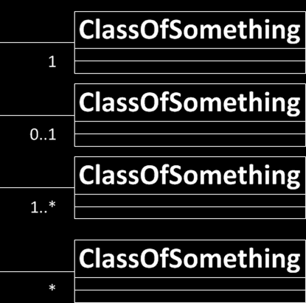
Multiplicity of Association
In computer science and engineering
* often means many
Hence,
1..*
1 to Many
*
0 to Many
Naturally
1
Exactly one
0..1
One or zero
If not specified, it means one
Notes:
As multiplicity plays a crucial role here, we’re going to delve more into the subject.
The multiplicity of an association can be classified in a variety of ways, and there are several types of multiplicity.
We’ve examined when there is a 1 and an asterisk.
It is customary to regard the asterisk as a multiple in the field of computer science or engineering.
For instance, we can call it 1-to-many.
1-to-many means it can be single or multiple.
It is imperative that the counterpart should have at least one for the class.
However, we will just suppose a situation where there is only an asterisk.
In that case, it means 0-to-many.
What’s equivalent to it is when it is 0, up to any value. This is denoted as 0...*.
So, it can be interpreted as there could be none or many.
Now, let’s move on to a customer example.
When you first passed through the constructor, you will find empty IstAccount.
That means, it could be none.
Therefore, the previous case only used an asterisk.
If it is an internal rule for a bank that one customer should have at least one bank account, it should be a 1-to-many relationship.
And if it is 1, that means there should be at least one.
Let’s say there is an account like this.
It is an account jointly owned by a number of customers.
Now, it’s possible that there are several account holders for a single account.
If a bank insists on categorically having one account holder, however, it’s not possible for an account to have 0 account holders.
If It is imperative to have at least one account holder. If it must only be a single person, it is marked as 1.
This information will be used when we define member variables later.
Let’s consider a situation when it is 0...1.
It can be interpreted as there is none or one.
If there is no association multiplicity here in some UML class diagram with no other indication, it will be regarded to have 1.

Slide 22

Aggregation
Special case of association
Special has-a relationship
More like, part-whole or part-of relationship
A family member is a part of a family
The existence of the family depends on the aggregation of the family member
If nothing to aggregate, there is no family
Hollow diamond shape
Aggregation often occur
when an aggregating class is a collection class
When the collection class’s life cycle depends on the collected classes
Notes:
Now, we will explore a relationship similar to an association but with different meanings.
We’ll be examining aggregation.
A generalization relationship is an is-a relationship, and an association relationship is called a has-a relationship. An aggregation relationship is also a has-a relationship, but it has additional meanings.
This twist in the has-a relationship can be called either a part-of or part-whole relationship.
Let’s look at this case as an example.
A family member is a part of a family.
As you see here, this end is devoid of arrows. Instead, you can find a diamond-shaped arrow here.
For an association relationship, we would have an arrow like this here.
Another way to think about this notation is this.
A family has several family members, and it must have at least one family member.
As for that family member, it should have one family.
This may not hold true in reality, but we will just assume this for our example.
In this case, the relationship flowing from here to there is ordinary.
It can be solved with a single list.
We just need an attribute in which a family member points out a family.
And the multiplicity is well defined.
What’s unusual is the relationship when 1 is marked with an asterisk (*), but it only becomes a one-to-many relationship.
What kind of special relationship does a diamond shape generate?
Let’s bring our attention back to the family.
First, let’s assume that a family cannot exist if there are no people in it as family members.
That is to say, the life time of a family depends on the number of family members. Once there are no family members in the family, that family no longer exists.
In short, if there is nothing to aggregate, a family will not exist. For a family to be formed, it must aggregate family members.
That’s why we apply a hollow diamond shape. An aggregation relationship serves to define that the memory should be free, or erased, if a family holds no family members.
An aggregation relationship is used when a family class subject to aggravation is a collection class. Its significance is dependent on collecting.
An aggregation is used to clarify a collection class cycle. It’s always dependent upon the presence of a collected class.
We should note that this design requires us to double check the presence of a family member in a family if we find code that manages a family life cycle, which always controls family members, regardless of the fact that we’re following a class definition.

Slide 23
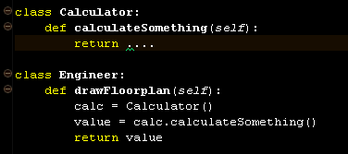

Dependency
Dependency between classes
use relationship
An engineer uses a calculator
May use for
Local variables
Method signatures
Parameter types
Method return types
Something that you import for the implementation
Notes:
The last relationship we’ll need to go over is a dependency relationship.
A dependency relationship is easy.
A dependency relationship is called a “use relationship.”
A use relationship means that it will import others to utilize methods within them.
It is not always necessary to store member variables by treating this class as an attribute.
A use relationship takes place when a better method is found in another class and then that better method is used.
For instance, there is some text, saying an engineer uses a calculator. It’s implemented like this.
When there is a class called engineer and a method named drawFloorplan, it will instantiate a calculator in the method. Then, the calculation will utilize some calculating method.
When this method ends, the calculator will vanish.
That’s because it’s a variable that’s internal to this program.
It is neither a member variable nor one that is stored.
It was made available only for the method to use.
After using it, it is marked by a dotted line with a simple arrow.
This is the dependency relationship.
It may also be used like a local variable.
It could be used as various return types.
If something is not adopted as a member variable, it is mostly a “use relationship.”
When you import something for implementation, it is a dependency relationship.

Slide 24
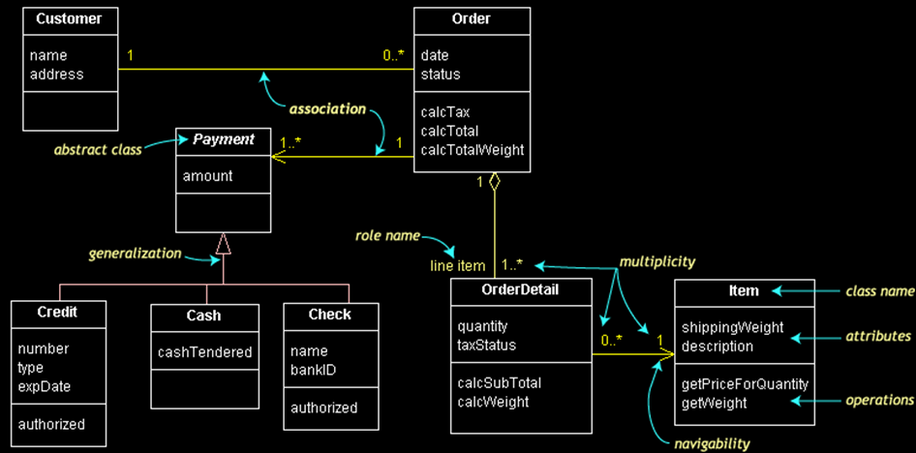
Let’s Practice
Notes:
Lastly, let’s sum up the various classes that we’ve covered so far and review the process of reading them.
If you look at this, you’ll find two attributes in a class named customer.
Another class, order, has two classes named as date and status. It also has a method related to three calculators.
Some people have not yet placed an order, while others already placed several orders.
Therefore, this situation falls into the category of a zero-to-many relationship.
An order is categorically placed by one customer, and it shows an association relationship that one order is invariably assigned to one customer.
Now, one order can hold various information.
Once a customer puts in an order, it would contain several concrete details.
An order can’t exist without details. So if there are no order details, there an order can’t be considered to be placed: there is no order.
This is what we would call an aggregation relationship.
Thus, an order has at least one order detail. It can also be classified as a one-to-many association relation.
The order details have items in each row.
This order details can describe how many goods are ordered and what happens with tax.
It is necessary for an order detail to contain at least one item of information.
We should know which goods are specified in the order. That’s because several units of the same good can be ordered.
If it’s one type of good, let’s consider that as 1.
One item cannot have many order details.
Although some items have never been ordered, popular items may be ordered many times.
So, this case would be a zero-to-many relationship.
In showing the relationship with arrows, a simple arrow points to one direction from here to there.
While the order detail has a complete list of item data, an item does not contain the full order details.
Thus, an order detail requires one variable to denote an item. An item, on the other hand, does not keep any information.
Under the order details, there should be at least one detail regarding payment.
The means of payment can be either credit card and cash.
As a result, this may give rise to a one-to-many situation.
However, when a payment is made with a credit card, a relevant order ensues.
Here, you will also find an association relationship that requires an order for a payment.
The payment must have an amount. Credit card payments need a credit card number, cash payments need to note how much money has received, and checks must have the name of the bank where the check has been issued.
By now, we’ve gone over a general overview of three types of relationships in programming.
We will wrap up this week’s lecture by learning how to read a simple class diagram.
In fact, it is good for you to learn how to read, but you’ve got to motivate and teach yourself to draw your own blueprints.
You should be able to draw in accordance with a given scenario. When it comes to architecture, in particular, there are some archetypes that dictate the general format for a restroom and the composition of a staircase.
An archetype is basically equivalent to a template. It provides us with some guidance over what are the common ways for designing something.
From archetypes, we can develop patterns.
These include a bridge pattern, a factory pattern, an adapter pattern, and more.
Later, when you review the lecture materials, you will recognize them as something that creates details for such a design based on class diagrams.

